Slide 1
CS2040S Tutorial 6

Slide 2
Recap

Slide 3
Union-Find

Slide 4
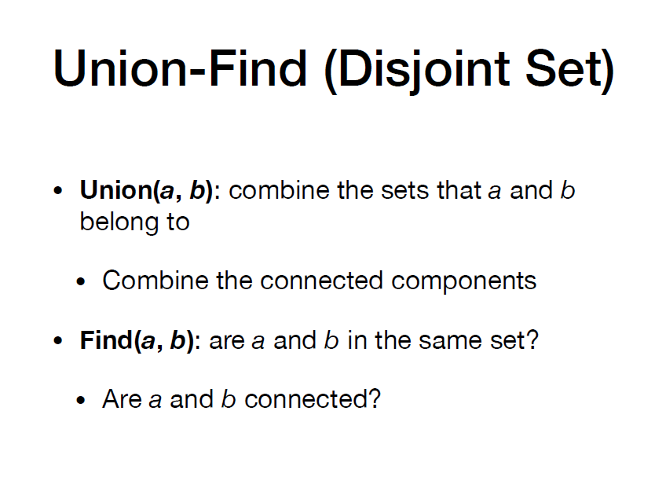

Slide 5
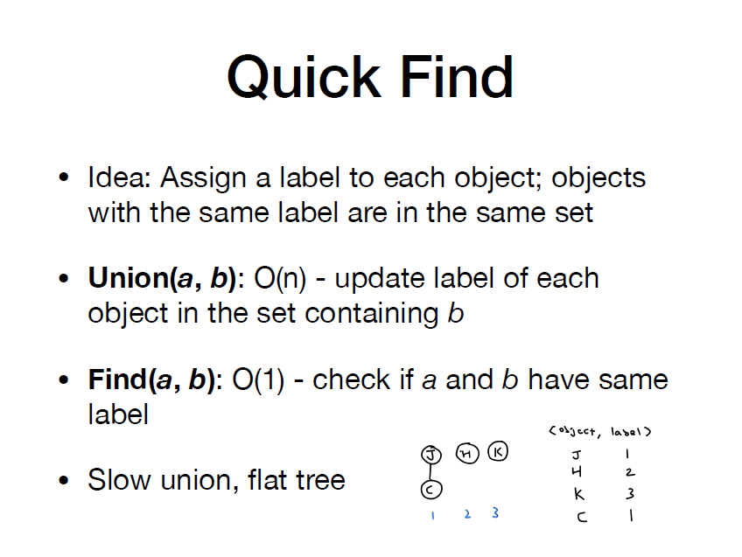

Slide 7
(You could need to update the label of a set of size O(n))

Slide 8
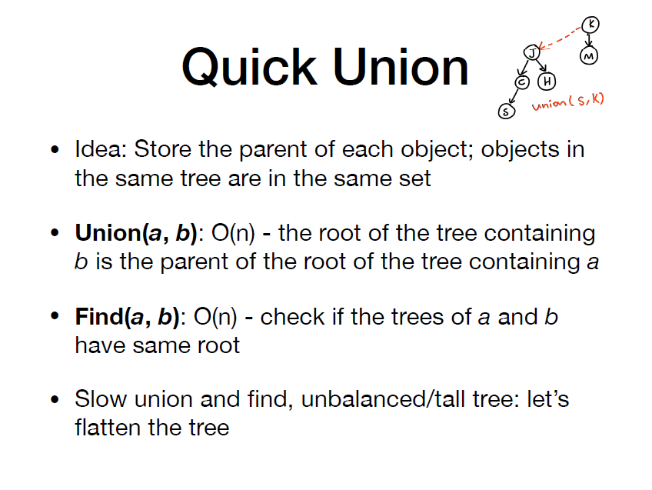

Slide 10
Possibly given the leaf of the tree of size O(n), and you have to traverse all the way to find the parent

Slide 11
Possibly given the leaf of the tree of size O(n), and you have to traverse all the way to find the parent

Slide 12
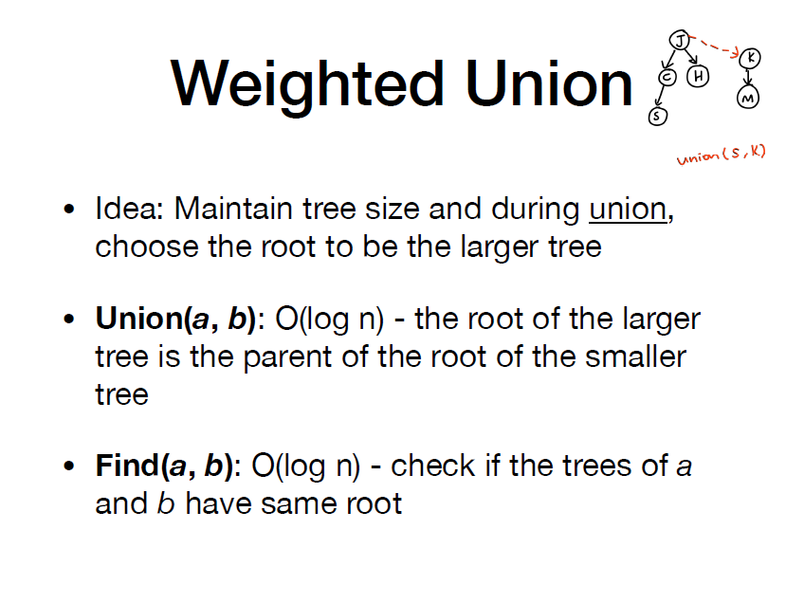

Slide 14
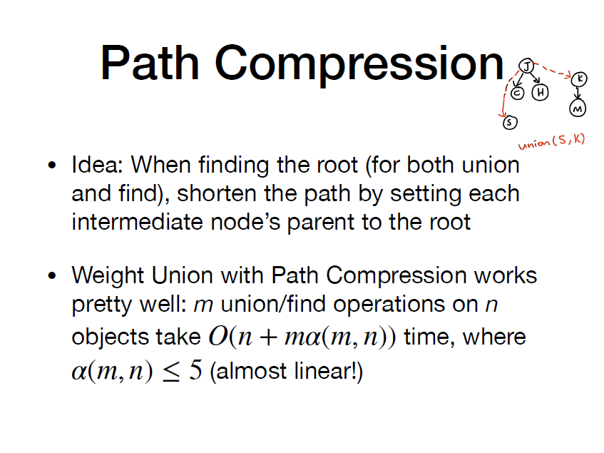

Slide 15
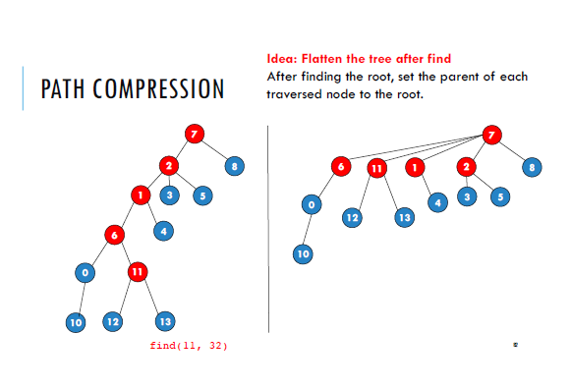
Taken from Prof Harold’s AY19/20 S1 slides (with permission)

Slide 17
Tutorial Problems

Slide 18
1a - Priority queue
There are situations where, given a data set, we want to know the top k highest value elements. A possible solution is to store all n elements first, sort the data set in O(n log n), then report the right-most k elements. You can assume that elements in the data set are unique.
(a) Find the top k largest elements better than O(n log n);

Slide 19
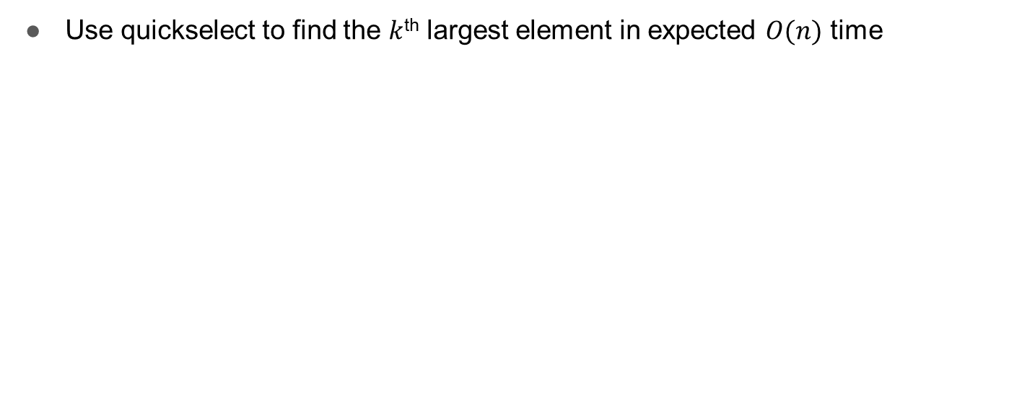
1a - Priority queue

Slide 20
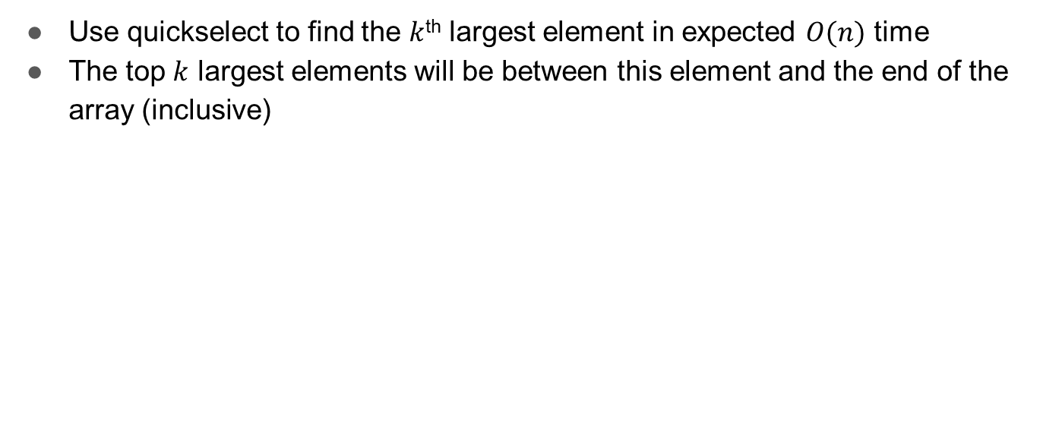
1a - Priority queue

Slide 21
1b - Priority queue
(b) Find the top k largest elements as the elements are streaming in (for each new element that is given to you, your data structure must be ready to answer queries for the top k largest elements efficiently), and the algorithm runs faster than O(n log n).

Slide 22
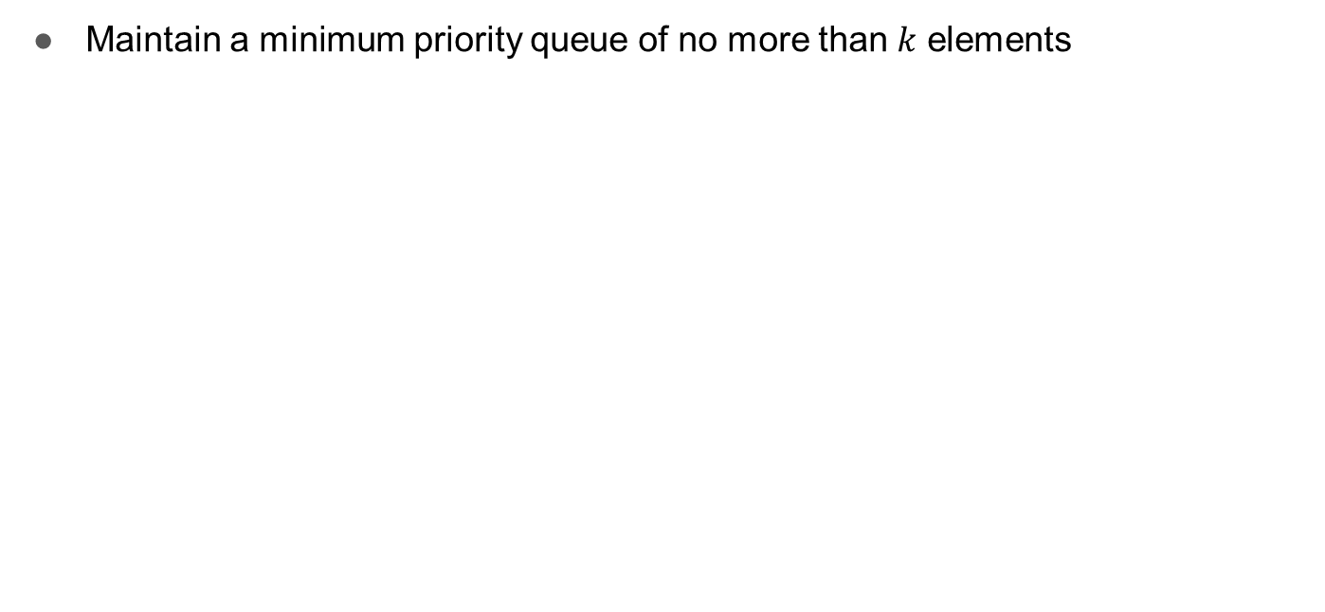
1b - Priority queue

Slide 23
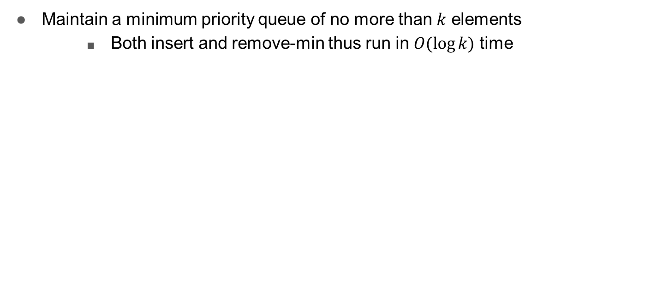
1b - Priority queue

Slide 24
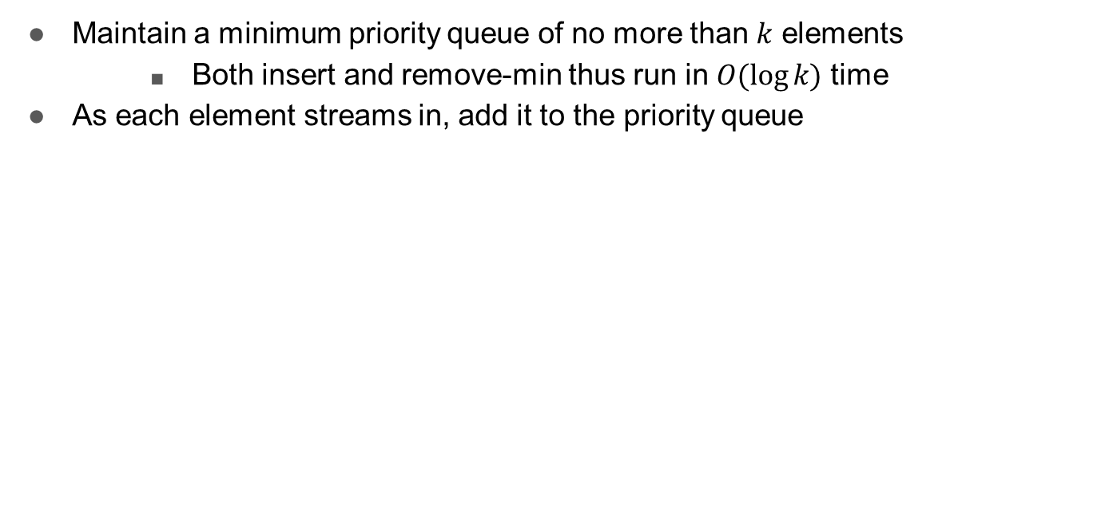
1b - Priority queue

Slide 25
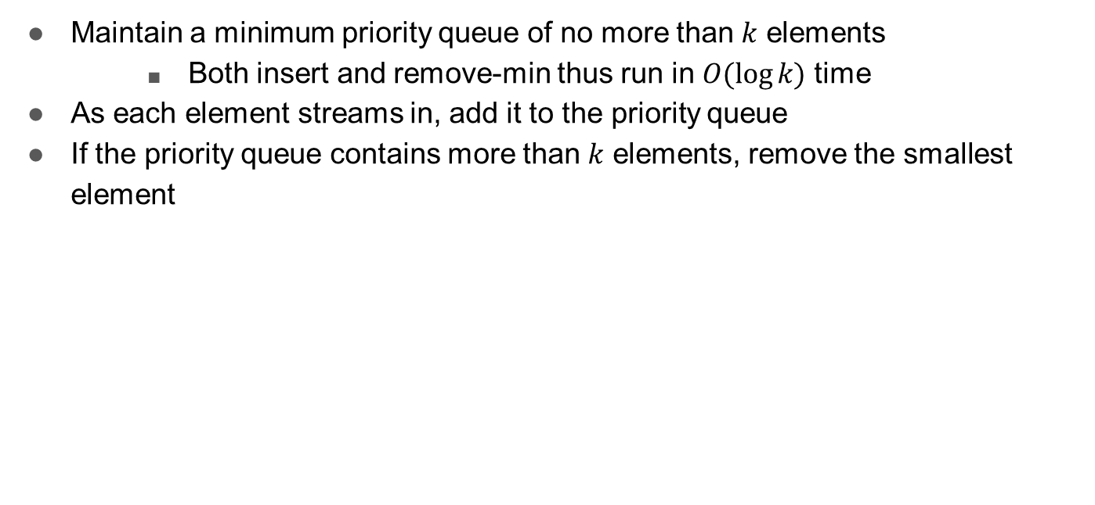
1b - Priority queue

Slide 26
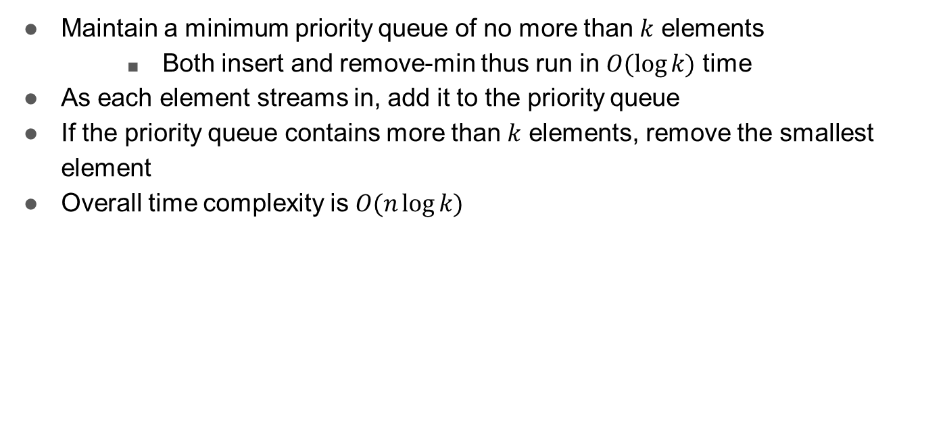
1b - Priority queue

Slide 27
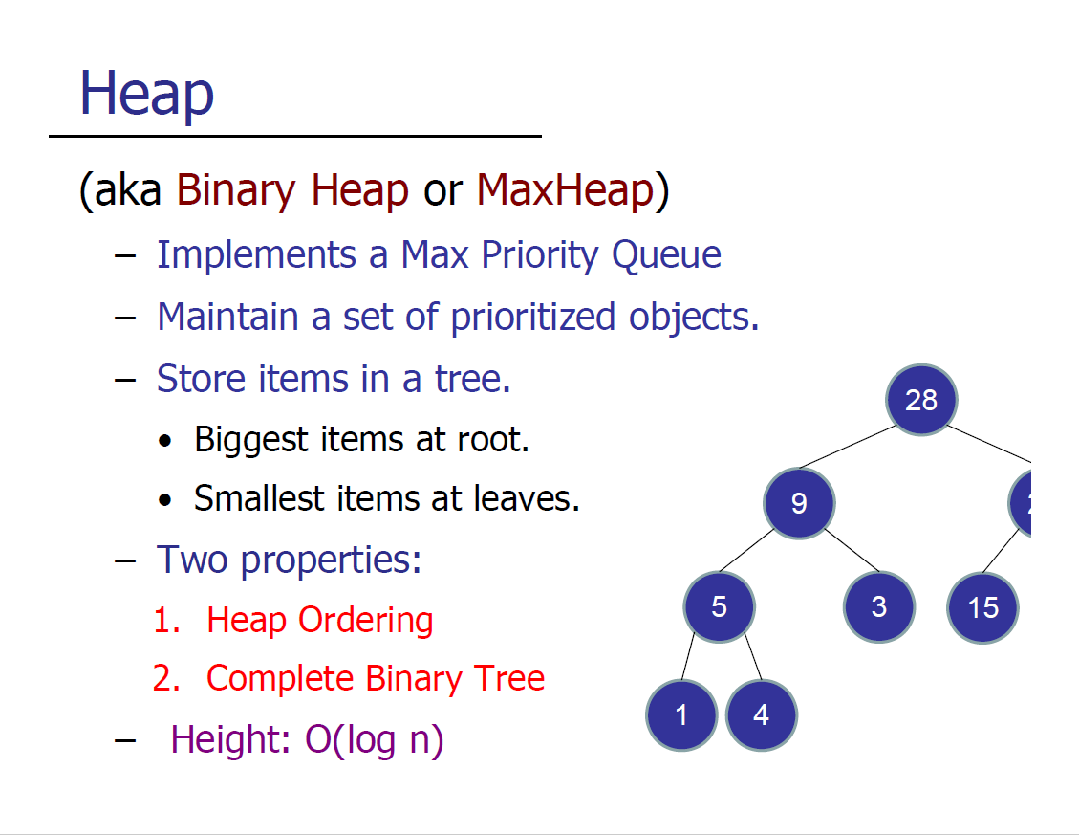

Slide 28
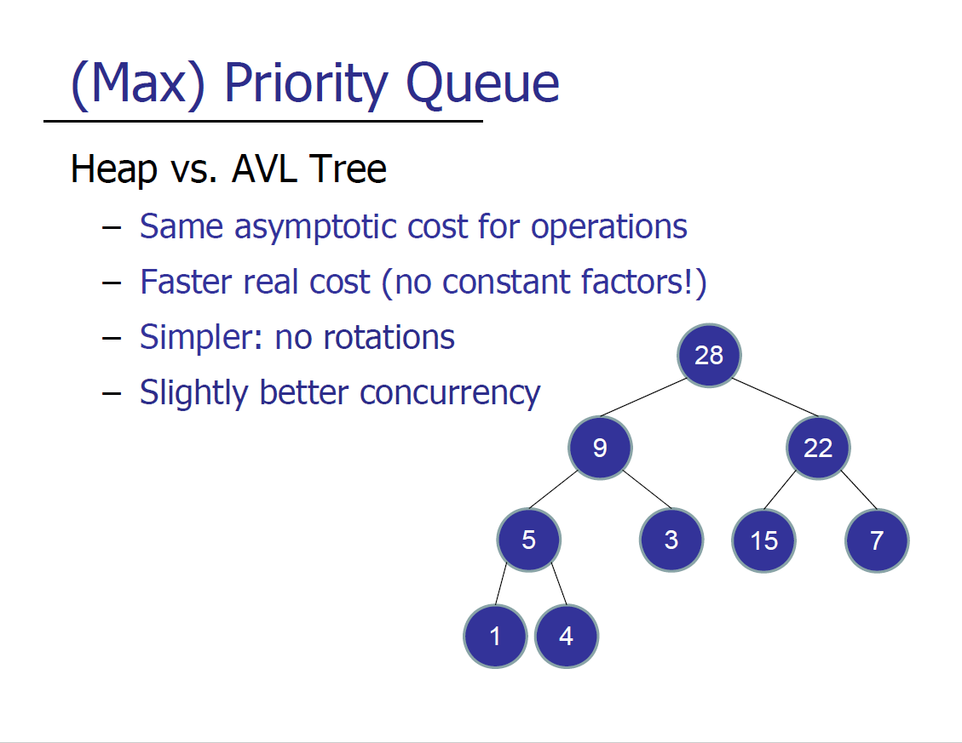
Since a heap is a complete binary tree, it can be represented by an array as the underlying data structure, which is much more efficient than having to create objects for nodes!

Slide 29
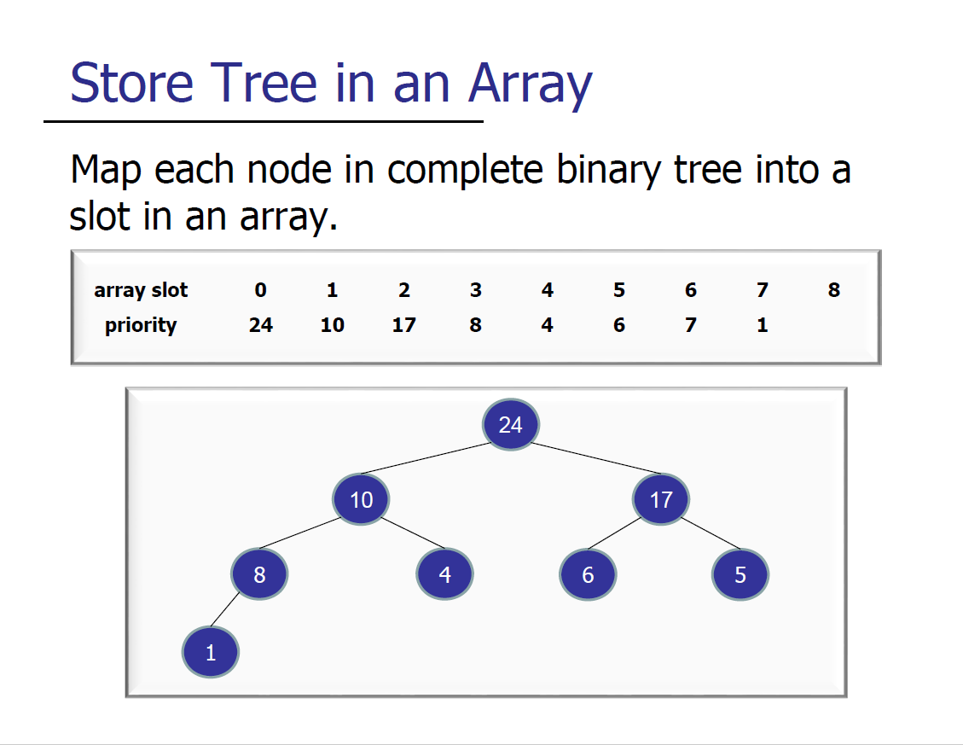

Slide 30
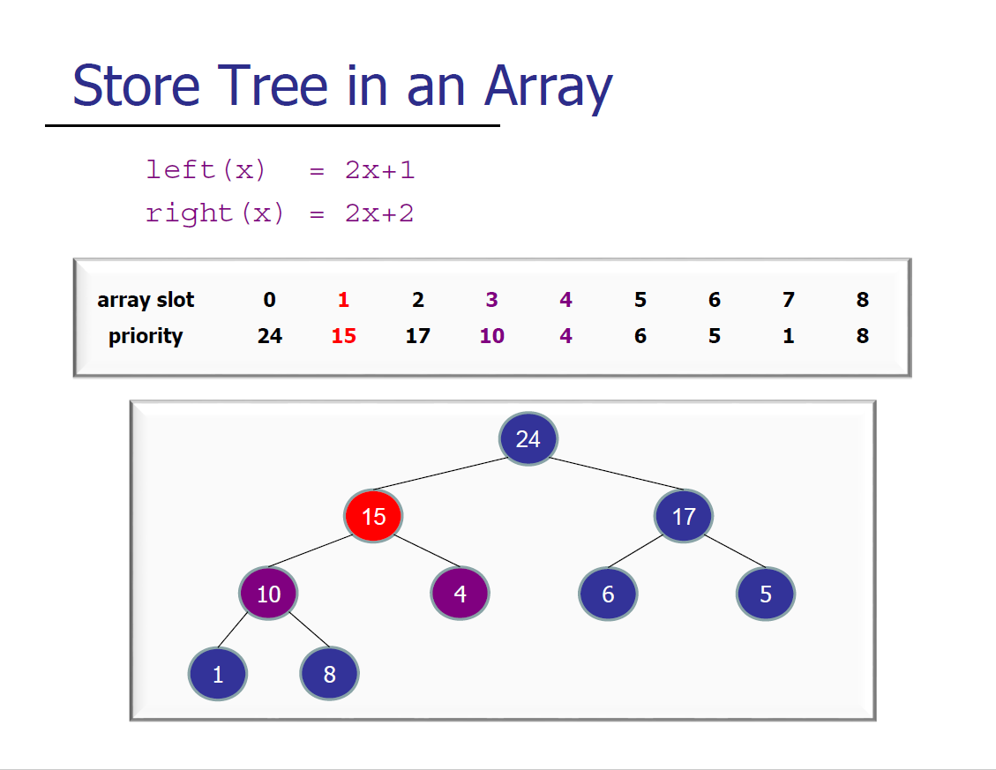

Slide 31
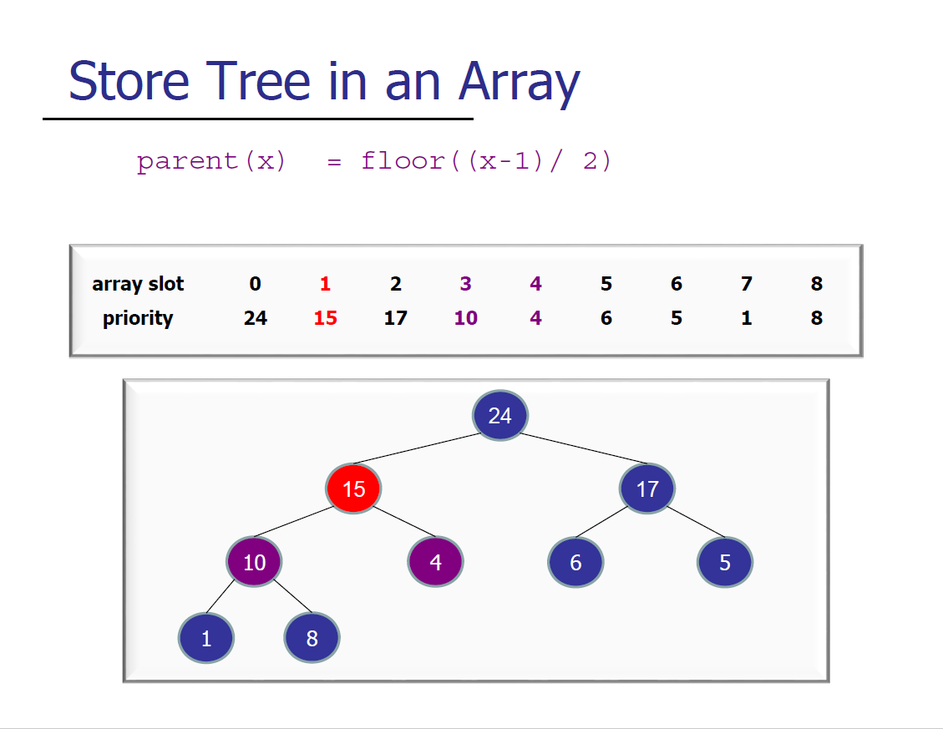

Slide 32
3a – Union-find
What is the worst-case running time of the find operation in Union-Find with path compression (but no weighted union)?

Slide 33
3a – Union-find
Credits to Matthew for this diagram
1
2
3
4
5

Slide 34
3a – Union-find
Credits to Matthew for this diagram
1
2
3
4
5
Union(1, 2)
1
2
3
4
5

Slide 35
3a – Union-find
Credits to Matthew for this diagram
1
2
3
4
5
Union(1, 2)
1
2
3
4
5
Union(2, 3)
1
2
3
4
5

Slide 36
3a – Union-find
Credits to Matthew for this diagram
1
2
3
4
5
Union(1, 2)
1
2
3
4
5
Union(2, 3)
1
2
3
4
5
Union(3, 4)
1
2
3
4
5

Slide 37
3a – Union-find
Credits to Matthew for this diagram
1
2
3
4
5
Union(1, 2)
1
2
3
4
5
Union(2, 3)
1
2
3
4
5
Union(3, 4)
1
2
3
4
5
Union(4, 5)
1
2
3
4
5

Slide 38
3a – Union-find
Credits to Matthew for this diagram
1
2
3
4
5
Union(1, 2)
1
2
3
4
5
Union(2, 3)
1
2
3
4
5
Union(3, 4)
1
2
3
4
5
Union(4, 5)
1
2
3
4
5
This linear length tree can potentially pick out a worst-case O(n) operations!

Slide 39
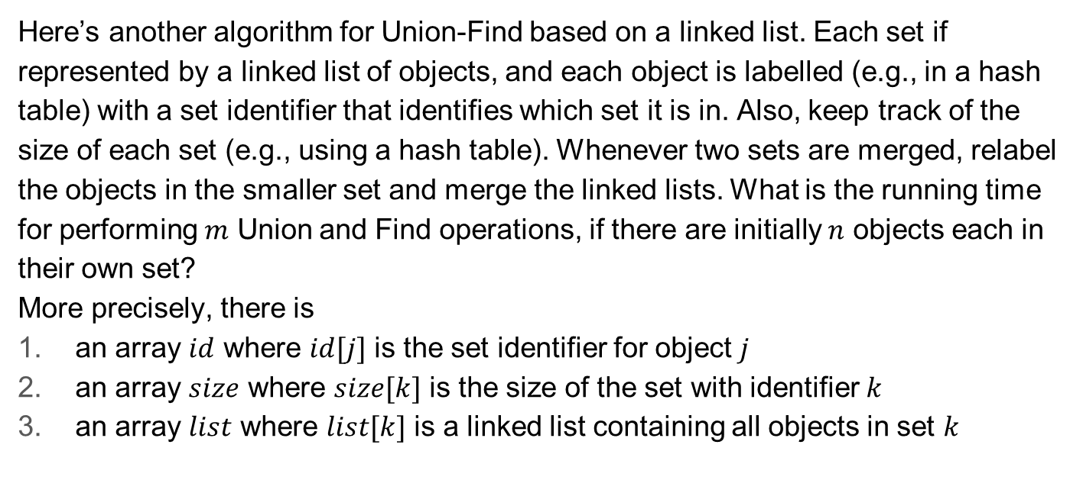
3b – Union-find

Slide 40
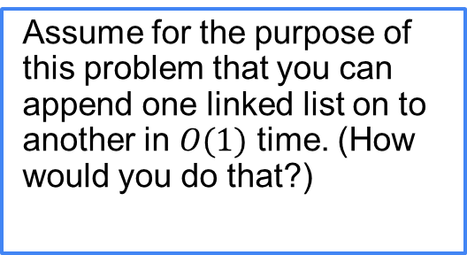
3b – Union-find
Find(i, j): return (id[i] == id[j]) Union(i, j): if size[i] < size[j] then Union(j, i) else // size[i] >= size[j] k1 = id[i] k2 = id[j] for every item m in list[k2]: set id[m] = k1 append list[k2] on the end of list[k1] and set list[k2] to null size[k1] = size[k1] + size[k2] size[k2] = 0

Slide 41

3b – Union-find

Slide 42
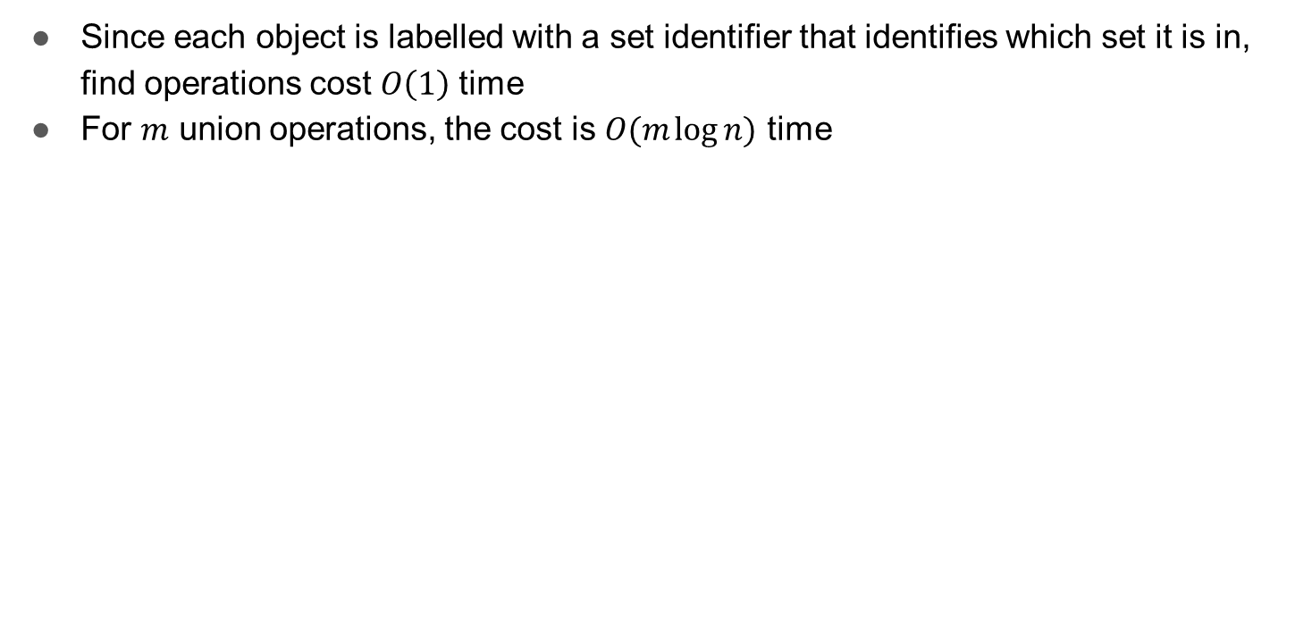
3b – Union-find

Slide 43
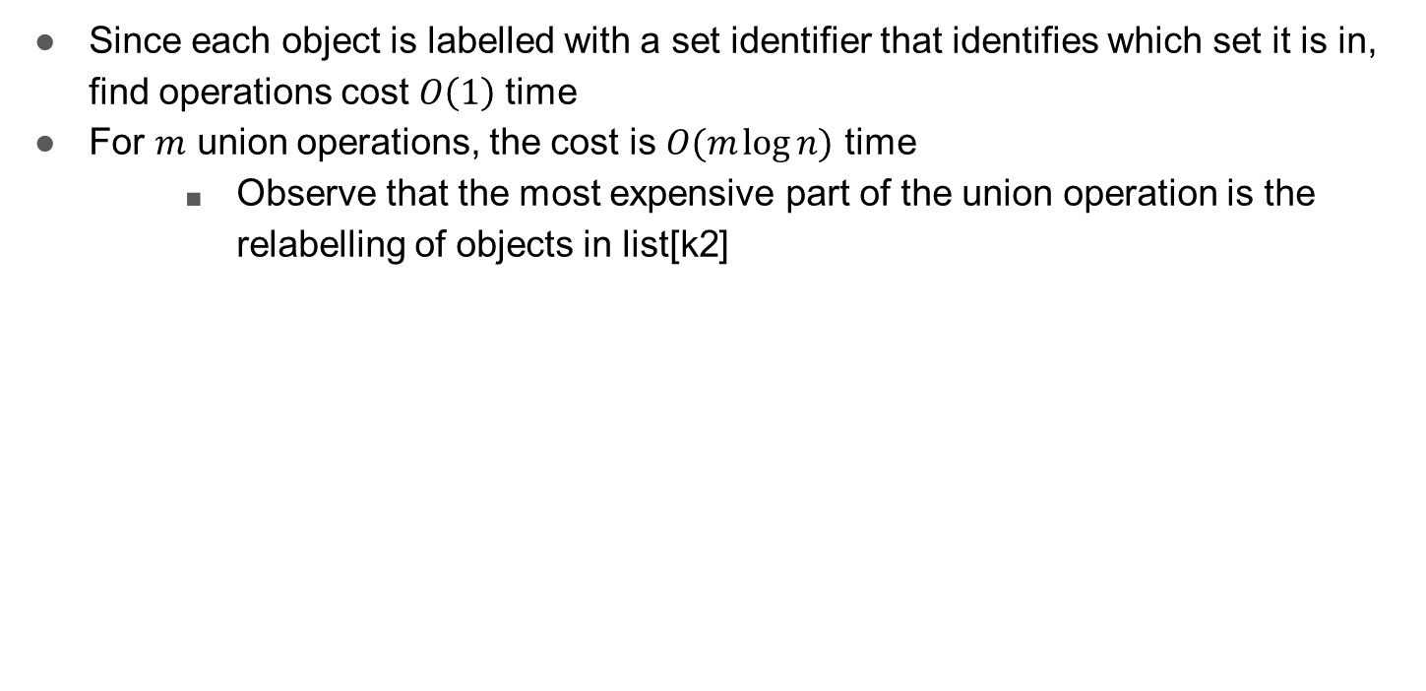
3b – Union-find

Slide 44
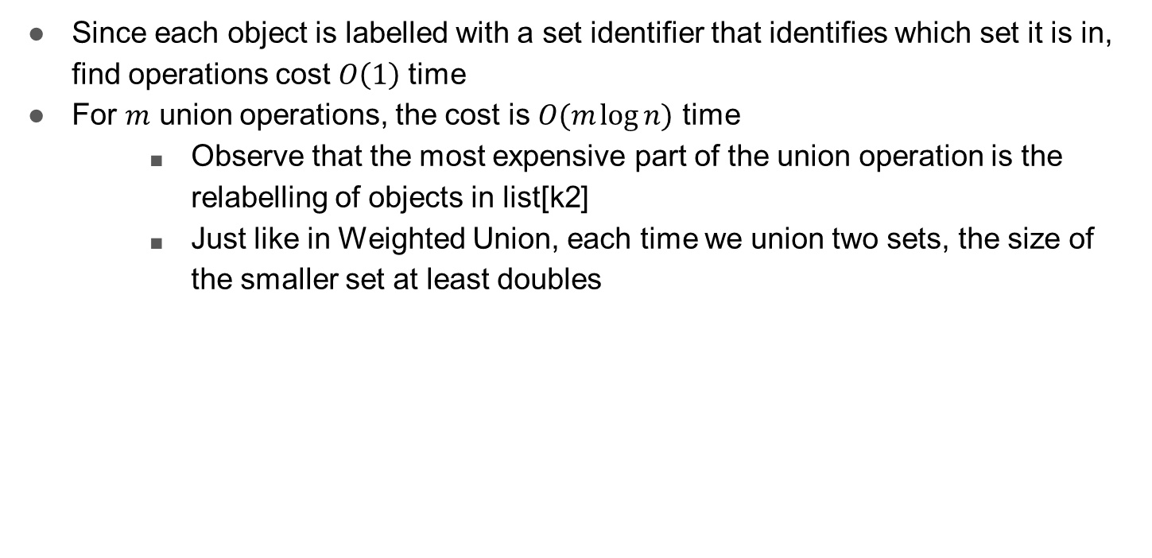
3b – Union-find

Slide 45
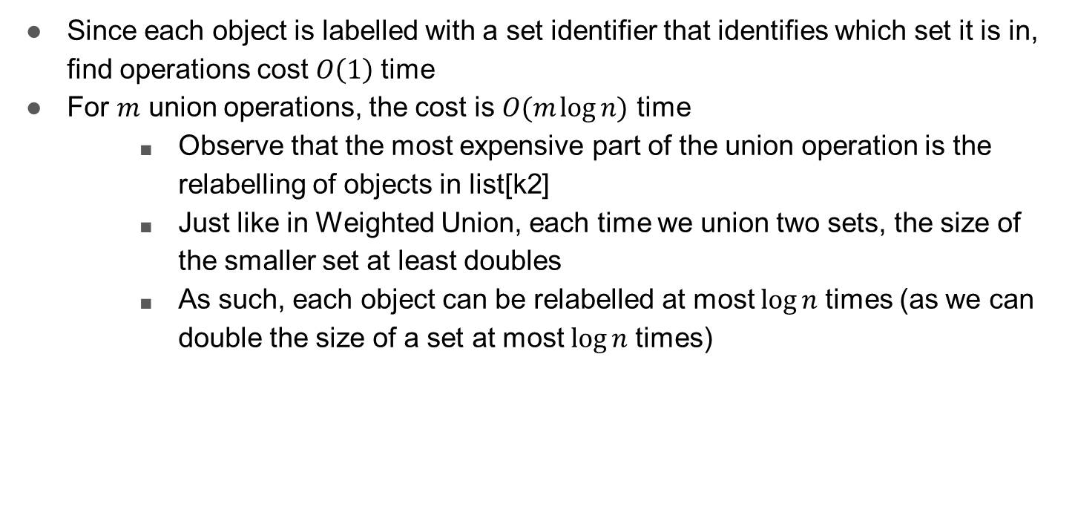
3b – Union-find

Slide 46
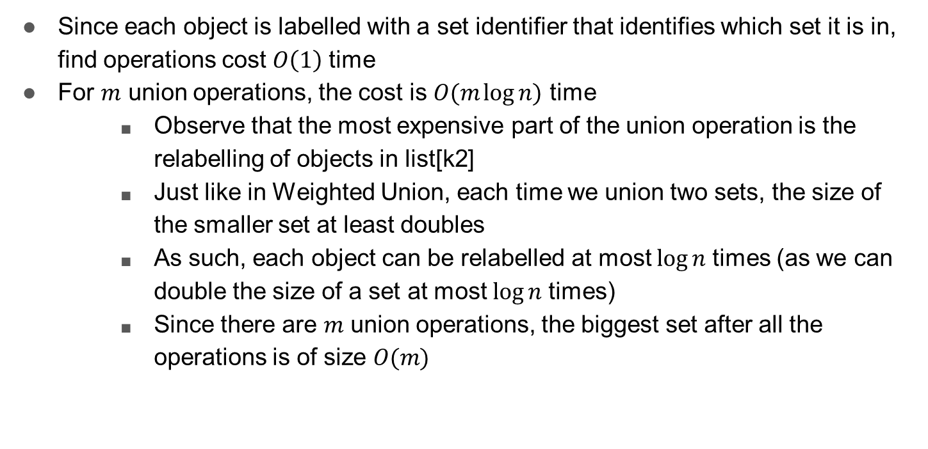
3b – Union-find

Slide 47
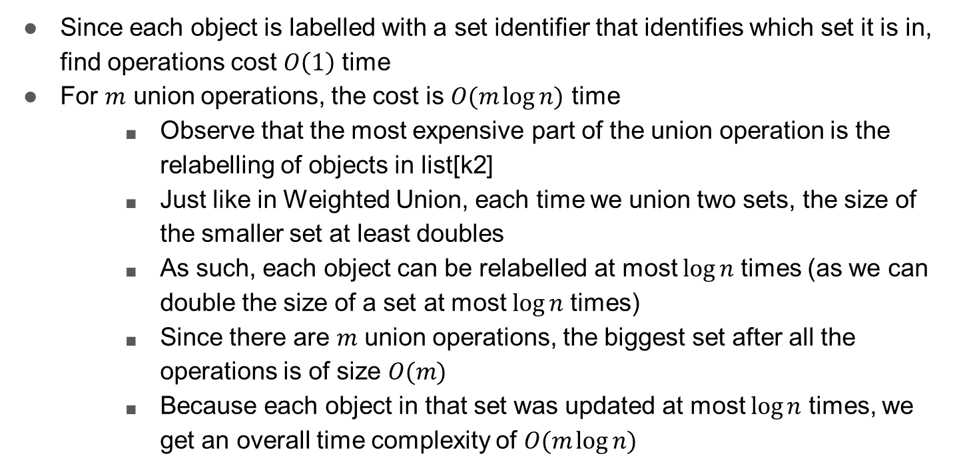
3b – Union-find

Slide 48
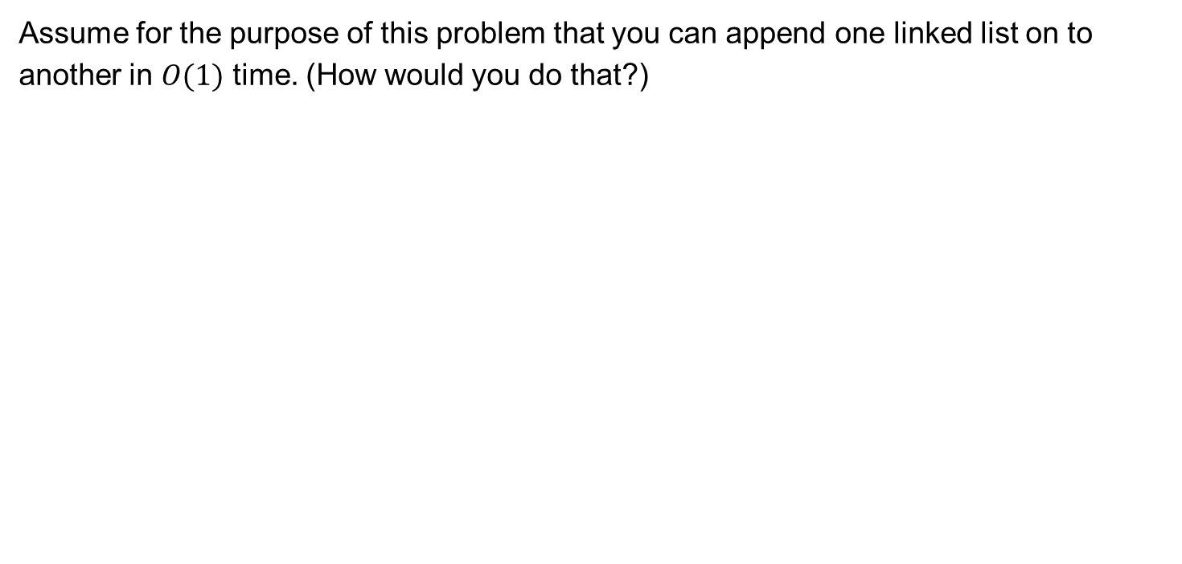
3b – Union-find

Slide 49
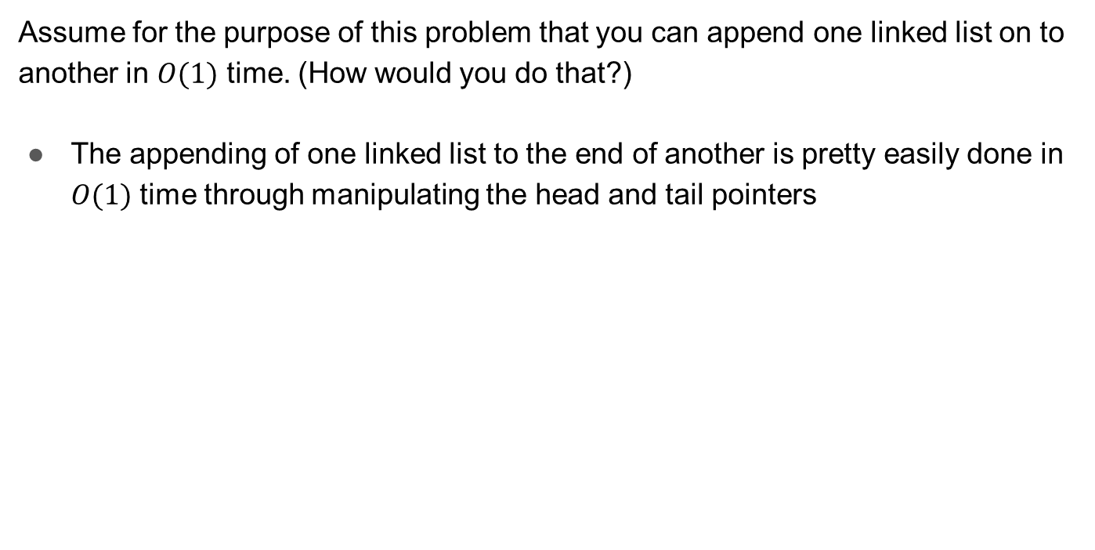
3b – Union-find

Slide 50
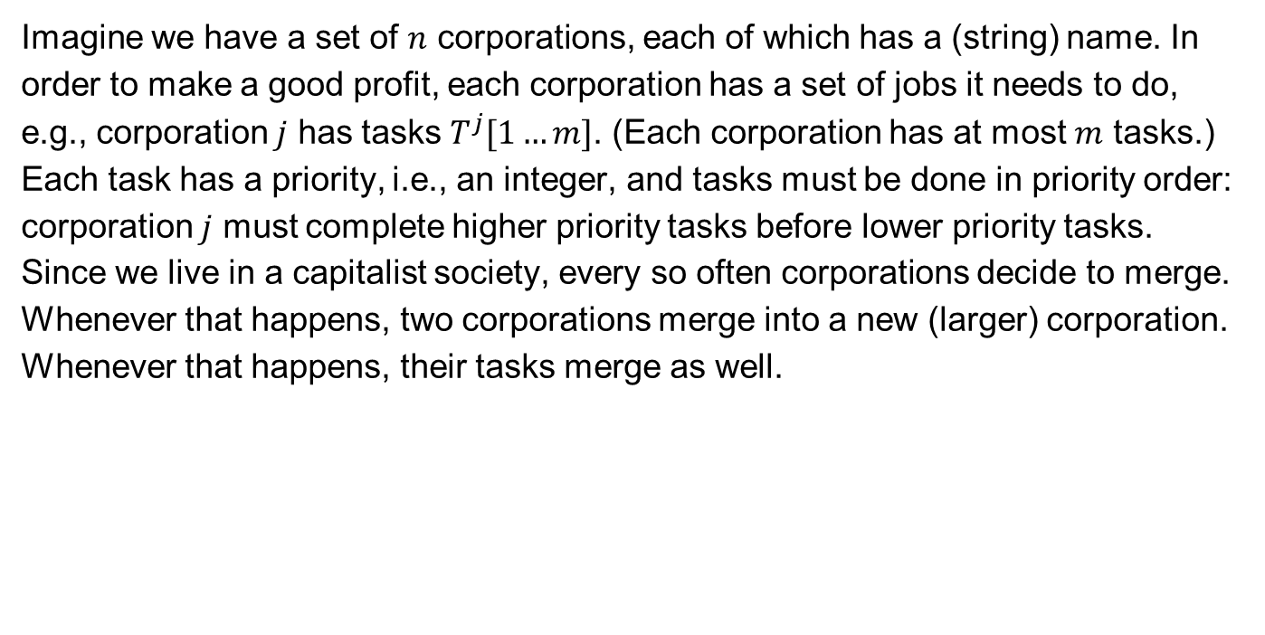
3c – Union-find

Slide 51
3c – Union-find
Design a data structure that supports three operations:
getNextTask(name) that returns the next task for the corporation with the specified name.
executeNextTask(name) that returns the next task for the corporation with the specified name and removes it from the set of tasks that corporation needs to do.
merge(name1, name2, name3) that merges the corporations with names name1 and name2 into a new corporation with name3.
Give an efficient algorithm for solving this problem.

Slide 52
3c – Union-find
Can be solved using the same technique as the previous part, except we use a heap to implement a priority queue for each corporation, rather than a linked list

Slide 53
3c – Union-find
Can be solved using the same technique as the previous part, except we use a heap to implement a priority queue for each corporation, rather than a linked list
To get the next (highest priority) task for a corporation, we peek the max element in the priority queue

Slide 54
3c – Union-find
Can be solved using the same technique as the previous part, except we use a heap to implement a priority queue for each corporation, rather than a linked list
To get the next (highest priority) task for a corporation, we peek the max element in the priority queue
To execute the next (highest priority) task for a corporation, we pop the max element in the priority queue

Slide 55
3c – Union-find
To merge two corporations, take the smaller remaining set of tasks and add them all to the priority queue of the corporation with the larger set of tasks

Slide 56
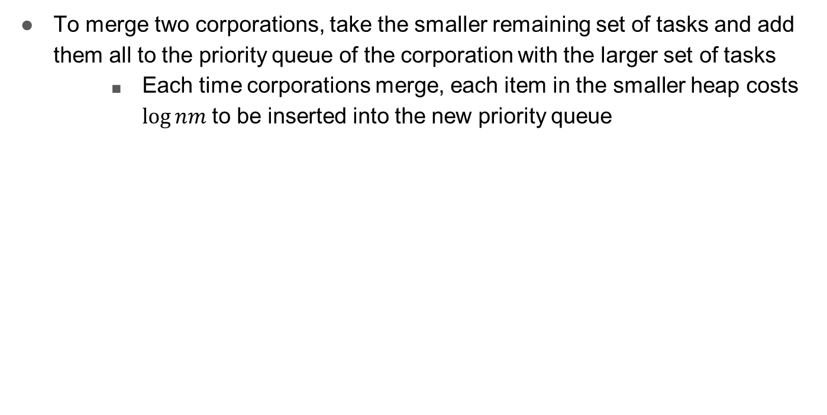
3c – Union-find

Slide 57
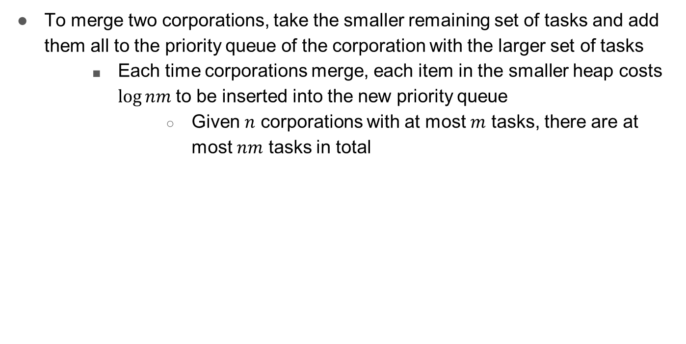
3c – Union-find

Slide 58
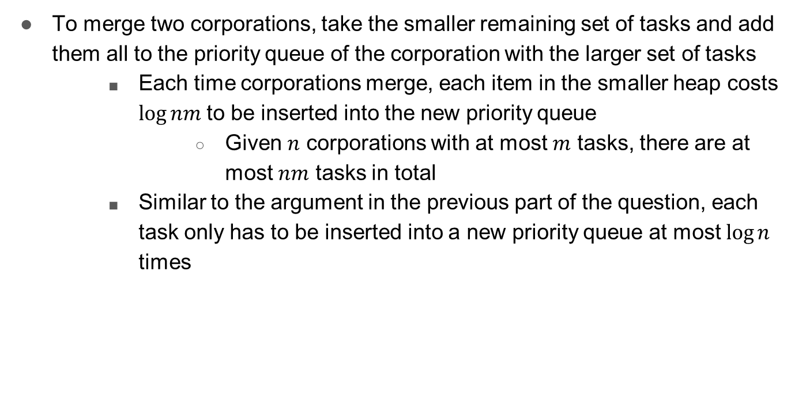
3c – Union-find

Slide 59
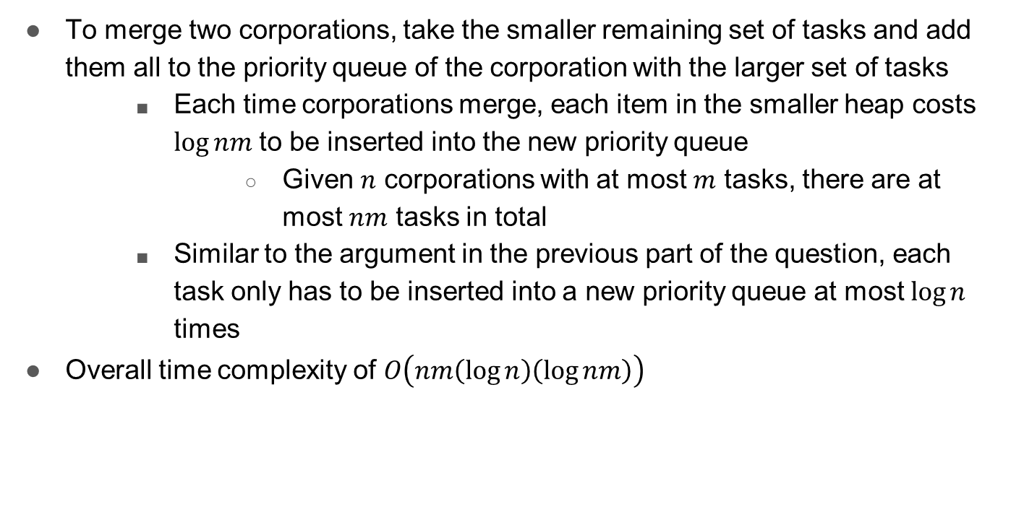
3c – Union-find

Slide 60
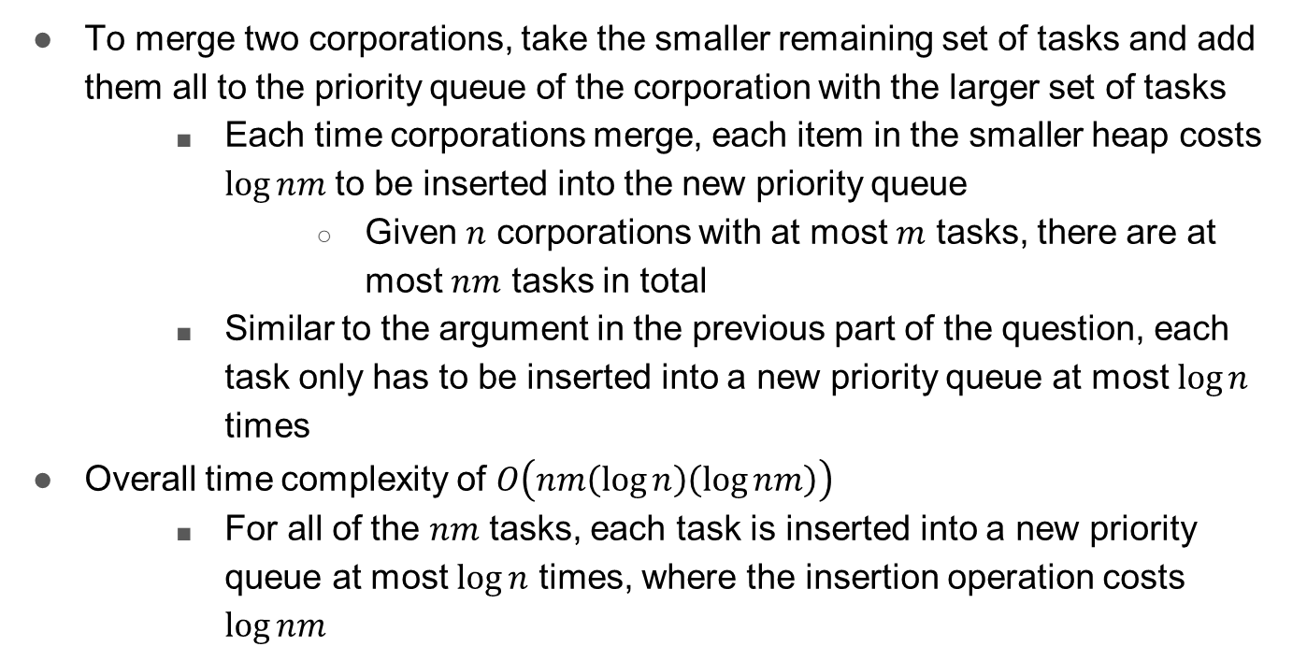
3c – Union-find

